Slide 1
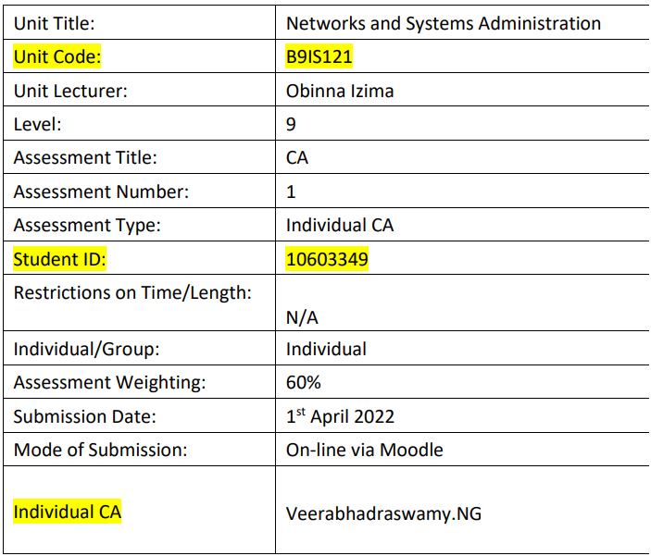

B9IS121 Networks and Systems Administration (B9IS121_2122_TMD2)
Veerabhadraswamy.NG (10603349)

Slide 2
B9IS121 Networks and Systems Administration (B9IS121_2122_TMD2)
Scenario:
Establish a secure Campus area network between Admin and branch department.
Further analyze the network traffic and provide solution for the observed security risks.
Applications used:
Serial No | Software | Version
1 | GNS3 | 2.2.31
2 | Cisco Packet Tracer | 6.2.0.0052
3 | Wireshark | 3.6.2
Veerabhadraswamy.NG (10603349)

Slide 3
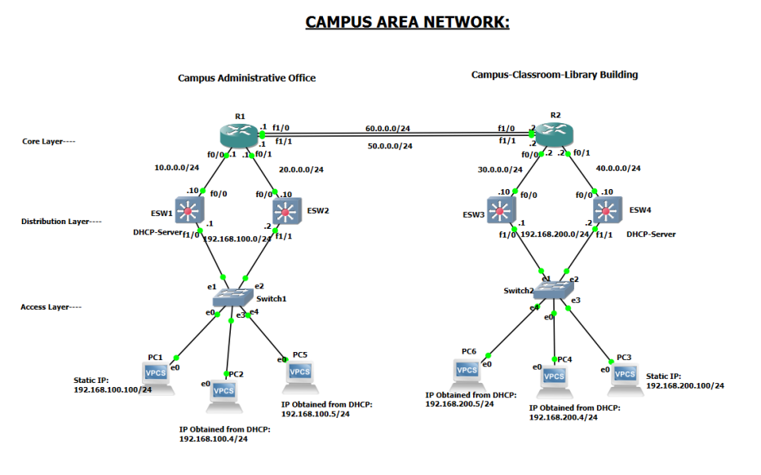
B9IS121 Networks and Systems Administration (B9IS121_2122_TMD2)
Veerabhadraswamy.NG (10603349)

Slide 4
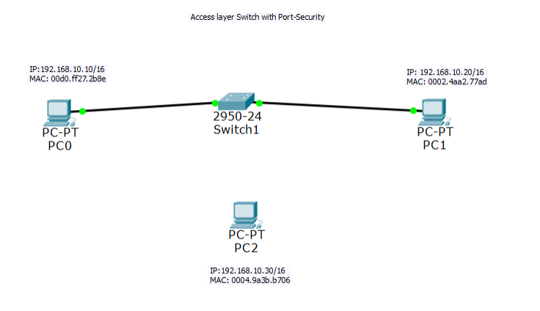
Cisco Packet-Tracer topology to simulate layer-2 Port-Security feature
B9IS121 Networks and Systems Administration (B9IS121_2122_TMD2)
Veerabhadraswamy.NG (10603349)

Slide 5
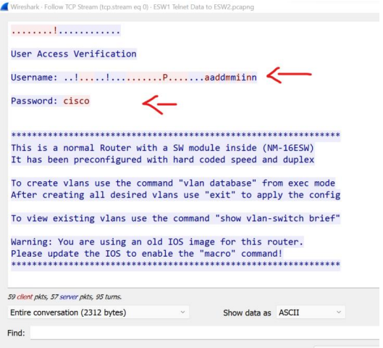
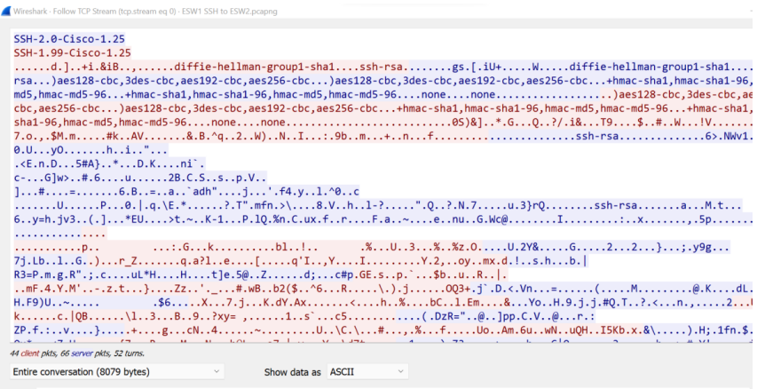
Telnet and SSH Wireshark Analysis
B9IS121 Networks and Systems Administration (B9IS121_2122_TMD2)
Veerabhadraswamy.NG (10603349)

Slide 6
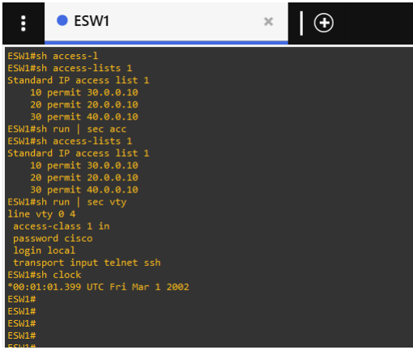
Access-list:
B9IS121 Networks and Systems Administration (B9IS121_2122_TMD2)
Veerabhadraswamy.NG (10603349)

Slide 7
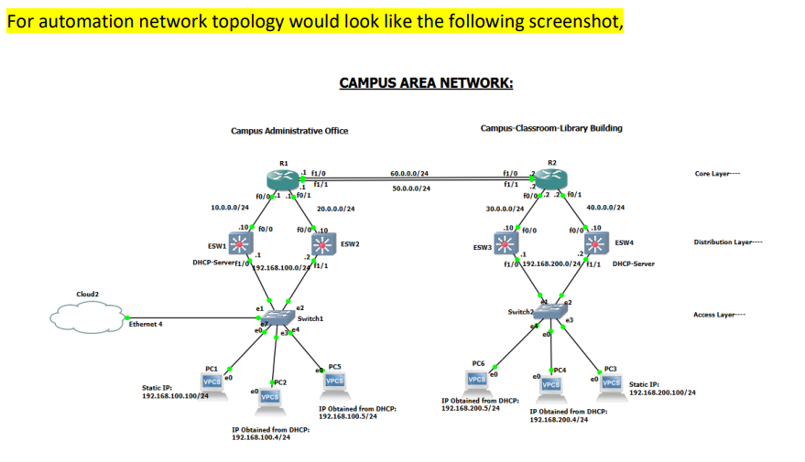
B9IS121 Networks and Systems Administration (B9IS121_2122_TMD2)
Veerabhadraswamy.NG (10603349)

Slide 8
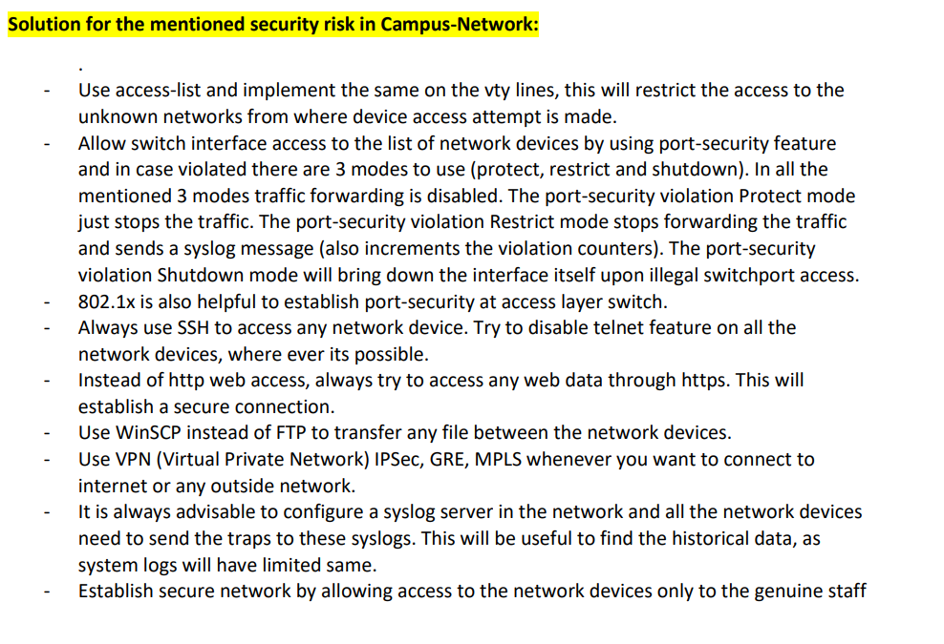
B9IS121 Networks and Systems Administration (B9IS121_2122_TMD2)
Veerabhadraswamy.NG (10603349)

Slide 9
Thank you
B9IS121 Networks and Systems Administration (B9IS121_2122_TMD2)
Veerabhadraswamy.NG (10603349)

